Slide 1
Production and Costs (Part 3)
Chapter 19.

Slide 2
The AVC and ATC Curves in Relation to the MC Curve
The Average – Marginal Rule: When the marginal magnitude is above the average magnitude, the average magnitude rises; when the marginal magnitude is below the average magnitude, the average magnitude falls.
Marginal > Average ➔ Average Goes Up
Marginal < Average ➔ Average Falls
Numerically..

Slide 3
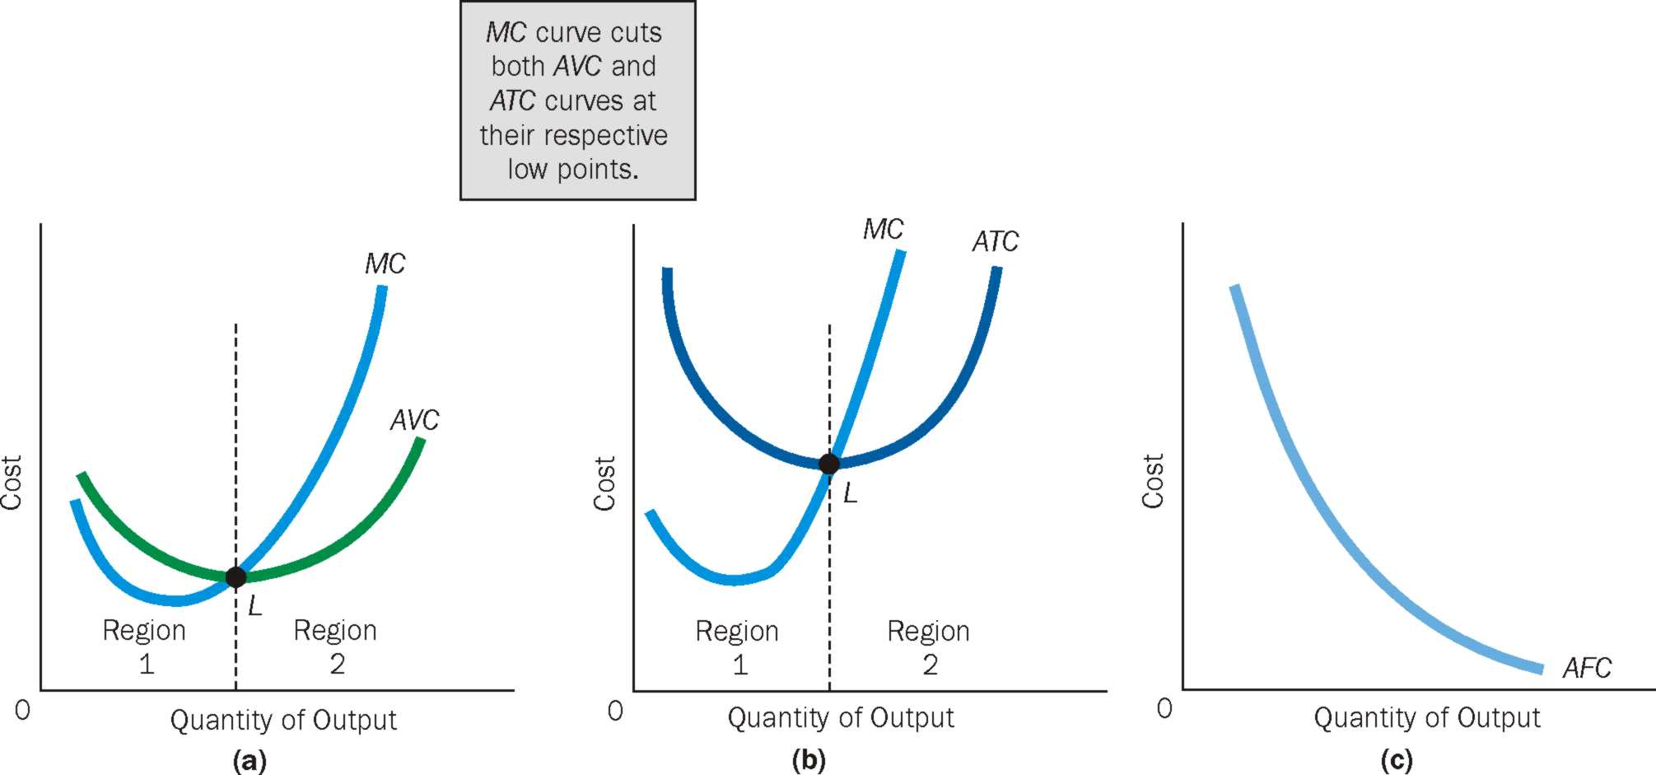
If MC < AVC ➔ AVC is falling; if MC > AVC ➔ AVC is rising, MC = AVC when AVC is minimum
If MC < ATC ➔ ATC is falling; if MC > ATC ➔ ATC is rising, MC = ATC when ATC is minimum
No relationship between AFC and MC.

Slide 4
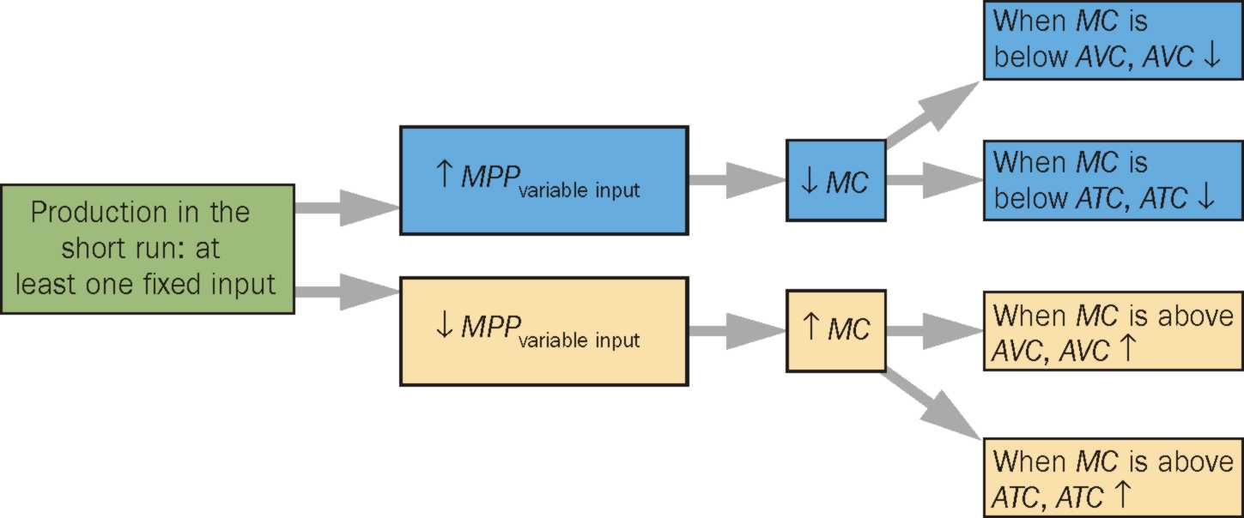
Tying Short-Run Production to Costs

Slide 5
One More Cost Concept: Sunk Cost
Sunk Cost: A cost incurred in the past that cannot be changed by current decisions and therefore cannot be recovered.
ECONOMISTS’ ADVICE: IGNORE SUNK COSTS
Once a sunk cost in incurred, it cannot be recovered.
Taking sunk costs into the decision making process leads to opportunity costs being ignored, since everything (even time) has an opportunity cost.
Further, it leads to a risk of compounding the cost.
Bottom line: A present decision can affect only the future, not the past. Ignore sunk costs as they happened in the past.

Slide 6
Production and Costs In The Long Run
In the long run, no inputs are fixed inputs and no fixed costs
All costs are variable ➔ Firm has greater flexibility in long run.
Long-run Average Total Cost
TVC = TC (TFC = 0 in long run)
Long Run Average Total Cost Curve shows the lowest unit cost at which the firm can produce any given level of output.

Slide 7
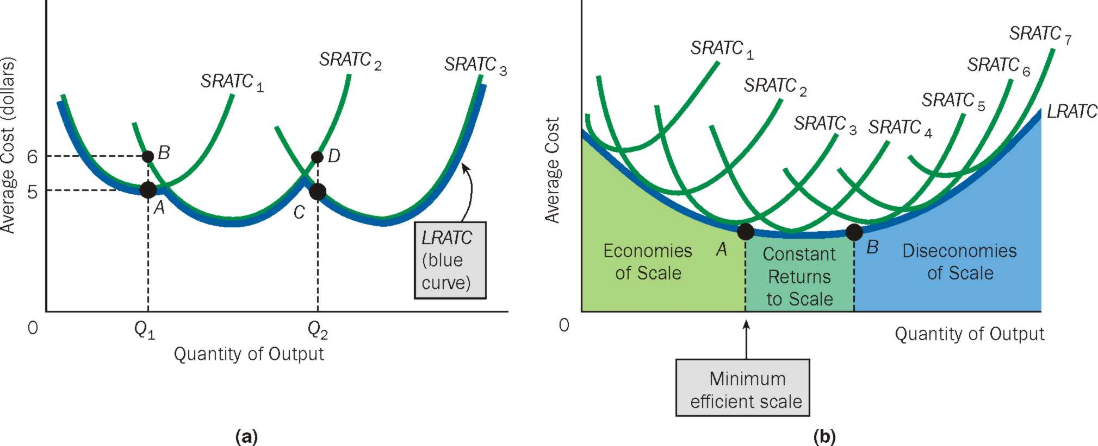
Production and Costs In The Long Run

Slide 8
Economies of Scale, Diseconomies of Scale and Constant Returns to Scale
Economies of Scale exist when inputs are increased by some percentage and output increases by a greater percentage, causing unit costs to fall. ➔ LRATC is falling
Constant Returns to Scale exist when inputs are increased by some percentage and output increases by an equal percentage, causing unit costs to remain constant. ➔ LRATC is constant
Diseconomies of Scale exist when inputs are increased by some percentage and output increases by a smaller percentage, causing unit costs to rise. ➔ LRATC is rising
Minimum Efficient Scale is the lowest output level at which average total costs are minimized.

Slide 9
Why Economies of Scale?
Up to a Certain Point, Long – Run unit Costs of Production Fall as a Firm Grows because of the following reasons:
Growing firms offer greater opportunities for employees to specialize.
Growing firms can take advantage of highly efficient mass production techniques and equipment that ordinarily require large setup costs and thus are economical only if they can be spread over a large number of units

Slide 10
Why Diseconomies of Scale?
Arises due to the following issues coming up because the firm is too big:
Difficulty in coordinating work activities
Communicate the tasks to the right people in a timely way
Monitoring employees effectively
These are avoided by:
Reorganizing and dividing tasks and operations ➔ more specialization
Hire new managers, etc.

Slide 11
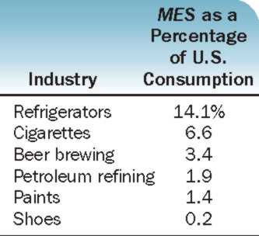
Minimum Efficient Scale and Number of Firms in an Industry
The MES as a percentage of US consumption or total sales is not same for all industries.
Firms in the cigarette industry reach MES of plant and thus exhaust economies of scale at an output level of 6.6% of total industry sales, compared to the shoes industry.
Minimum Efficient Scale can be divided as a percentage of U.S. consumption into 100, we can estimate the number of efficient firms it takes to satisfy U.S. consumption for a particular product.
The higher the MES, the fewer firms needed to satisfy the demand for that product

Slide 12
Shifts in Cost Curves
Taxes: affects variable costs. Because variable costs rise, total costs rise, and their average curves are shifted upward. Because marginal cost is the change in total cost divided by the change in output, marginal cost rises. All curves shift up in taxes increase, vice versa.
Input Prices: A rise or a fall in variable input prices causes a corresponding change in the firm’s average total, variable, and marginal cost curves. All curves shift up in input prices increase, vice versa.
Technological changes often bring either the capability of using fewer inputs to produce a good or lower input prices. . All curves shift down if positive technology change comes, vice versa.

